Slide 3
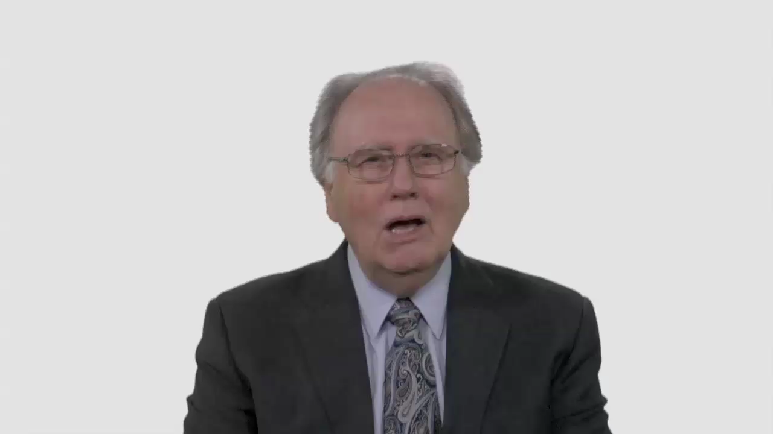

Slide 4
Have Your Say.
What do you think would happen
in your congregation if all elected leadership positions were filled
by people under age 35?

Slide 5
Conversation Builders.
Do you think making your church
more comfortable for young people would make it less comfortable
for the current members?

Slide 6
Conversation Builders.
How could young people
be more assertive about
seeking leadership roles?

Slide 7
Discussion Questions.
Is your church a place
where young people are
likely to feel at home?

Slide 8
Discussion Questions.
What are some characteristics
of a youth-friendly church?

Slide 9
Discussion Questions.
Are there things that make it
more difficult for leaders to hand
over meaningful responsibility
to younger members?

Slide 10
Discussion Questions.
What unique strengths
would young people bring to
leadership roles? Liabilities?

Slide 11
What Now?
Is your church ready to be
more intentional about giving
young people more
leadership responsibility?

Slide 12
What Now?
What are some practical
steps you could take to empower
your under thirty-fives?

Slide 13
What Now?
What goals would be realistic
for your congregation?

